Slide 1
District Leadership Team
Communication for Principals and ILTs
October 2019

Slide 2
2019-2020 DLT Members
Shauna Murphy – Assistant Superintendent
Carlos Blair – Western Hills
Chandra Gardner-Dater High School
Jennifer Myree – Rees E. Price
Beverly Pryor-Young-Virtual
Kendra Phelps – CFT
Amy Randolph – Oyler
Heather Stover – AWL
Harry Voll – Roselawn
Laura Sebastian - Hughes
Notes:
Kendra

Slide 3
Overview
What is this? Slides 4-8
School Identification
Why should we do this? Slides 9-10
Research
How will we do this? Slides 11-18
Quality Improvement PDSA
What is the role of the DLT in CPS? Slides 19-27
Purpose and communication
Notes:
Kendra

Slide 4
What is this?
Notes:
Paul and Joanna

Slide 5
Priority, Focus and Warning Schools
Notes:
Paul and Joanna

Slide 6
Priority Schools
CRITERIA 1: Schools with a four-year graduation rate of 67 percent or lower;
OR
CRITERIA 2: Lowest-performing schools using the report card’s overall grade methodology;
OR
CRITERIA 3: Failure to improve subgroup performance over the three-year identification period.
Focus Schools
CRITERIA 1: Schools with subgroups performing at or below the performance of Priority Schools;
OR
CRITERIA 2: Schools’ subgroups performing below in the bottom 30 percent and had low performance on the Gap Closing component.
Calculated from 2016-2017 AND 2017-2018 data.
Warning Schools
Schools with subgroups performing at or below the performance of Priority schools.
Calculated from 2017-2018 data ONLY.
Notes:
Joanna

Slide 7
Exit Criteria
Priority
School performance is higher than the lowest 5 percent of schools as determined by the overall report card grade for two consecutive years;
The school earns a four-year graduation rate of better than 67 percent for two consecutive school years; and
No student subgroups are performing at a level similar to the lowest 5 percent of schools (based on individual subgroup performance).
Focus and Warning
The school or district earns an overall grade of C or better as determined by the report card grade and earns a C or better for Gap Closing; and
The school meets subgroup performance goals per state requirements.
Notes:
Joanna

Slide 8
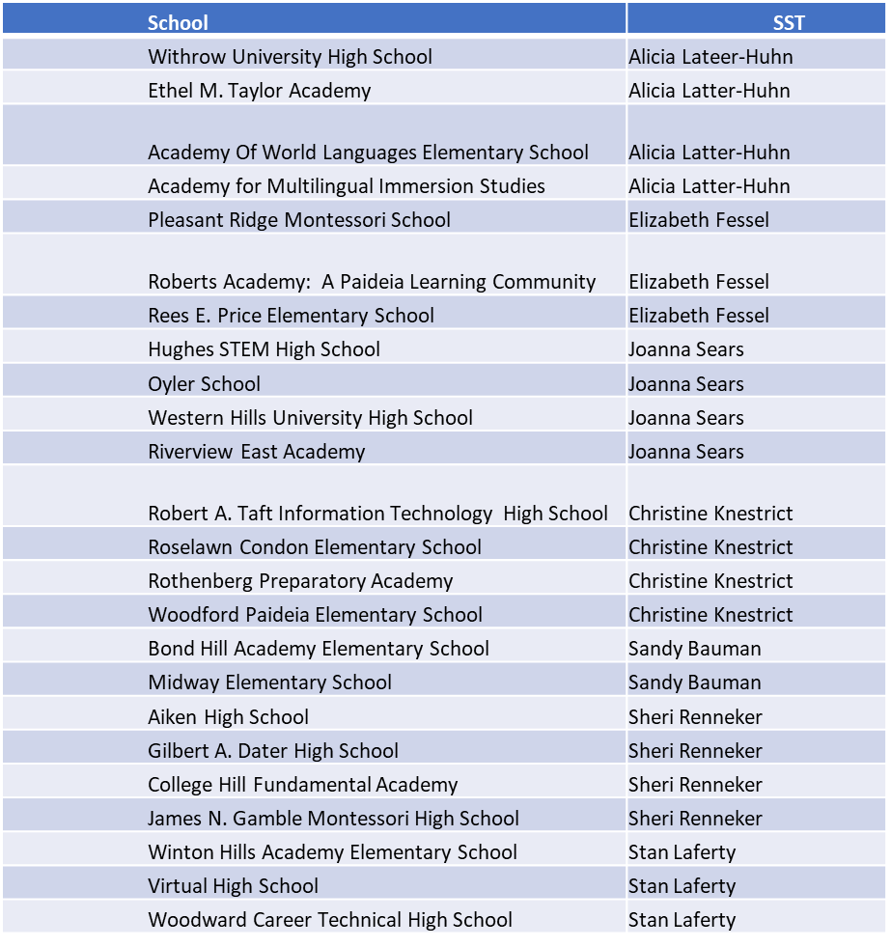
State Support Team (SST) Partners
Notes:
Paul and Joanna

Slide 9
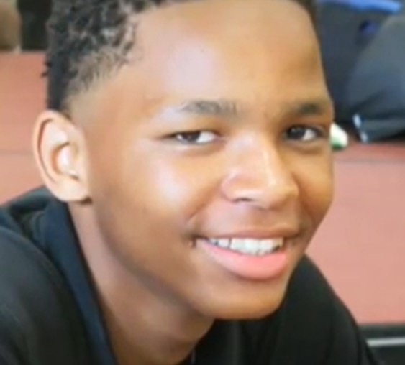
Why should we do this?
Notes:
???

Slide 10
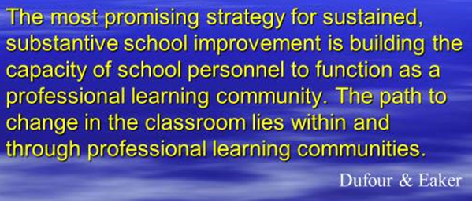
Professional Learning Communities
Create the opportunity for:
Collaboration through Professional Learning Communities
Focused and intentional action
Implementation of evidence-based practices
Communication to/from all levels (teacher/building/district)
Increased student achievement for all students
Celebration of successes

Slide 11
How will we do this?
Notes:
Jennifer and Heather

Slide 12
Instructional Leadership Team (ILT)
District Leadership Team (DLT)
Build capacity within the buildings for Professional Learning Communities to exist
Support ILT Implementation of strategies
Analyze district data to identify trends and areas of focus
Determine support needed for Priority and Focus schools
Inform decisions related to district PD and other initiatives
Support TBT implementation of strategies
Analyze building results to determine an area of focus
Use the PDSA process to evaluate building level strategies
Collect student performance and adult implementation data to share with DLT and to make building decisions around PD and other supports needed
TBT
ILT
DLT
Teacher Based Team (TBT)
Give common formative assessments to students and analyze results to determine an area of focus
Use the PDSA process to evaluate common instructional practices
Collect and summarize student performance and adult implementation data to share with ILT

Slide 13
District Leadership Team
Instructional Leadership Team
Instructional Leadership Team
Teacher Based Team
Teacher Based Team
Teacher Based Team
Teacher Based Team
Teacher Based Team
Teacher Based Team

Slide 14
Quality Improvement
A systems level problem solving method that engages all stakeholders.
Driving Questions:
What are we trying to accomplish?
How will we know the change is an improvement?
What change can we make that will result in an improvement?

Slide 15
The PDSA Process

Slide 16
CPS Key Driver Diagram (KDD)
Buildings create improvement plans based on the District’s Global Aim, Strategic Goals, and Key Drivers.

Slide 17
One Plan
Buildings will implement strategies and monitor progress towards goals using the ILT and TBT PDSA Process.

Slide 18
ILT and TBT Work
TBTs communicate monthly to ILT. TBT PDSA Form is provided as a guide.
DLT reviews ILT PDSA forms in January and March.
Notes:
Jennifer and Heather

Slide 19
What is the role of the DLT in CPS?
Notes:
Charlene

Slide 20
District Leadership Team
Build capacity within the buildings for Professional Learning Communities to exist
Analyze district data to identify trends and areas of focus
Use Student Performance and Adult Implementation Data to provide guidance and support to Priority and Focus Schools
Inform decisions related to district professional development and other initiatives

Slide 21
Communication
Use the ILT PDSA Form.
Make sure to complete the “Communication” section of this form so DLT can best support your teams.
Maintain all forms in the One Plan/ILT 19-20 folder.
Notes:
Charlene

Slide 22
What will the DLT do with the information?
The DLT will review information to look for patterns in the data, provide feedback, and determine how we can support.
Notes:
Charlene

Slide 23
DLT Review Dates
Oct 30 – One Plan
Jan 8 – ILT PDSA Forms
March 12 – ILT PDSA Forms
Notes:
Carlos

Slide 24
DLT Feedback and Support A slide will be added to the end of each school’s One Plan with this table.
Date | I Notice | I Wonder
10/30/19 One Plan
January ILT PDSA
March ILT PDSA

Slide 25
The DLT Role: Transparency and Support
Notes:
Tianay

Slide 26
What this is not . . . .
It is not evaluative.
It is not punitive.
It is not busy work.
It is not only compliance.
It is not one person’s responsibility.
Notes:
Tianay and Kendra

Slide 27
Questions?
Please feel free to contact the DLT Co-Chairs:
Kendra Phelps
kphelps@cft-aft.org
Amy Randolph
randola@cpsboe.k12.oh.us

